Slide 1
Statistical Analysis
Topic: Standard Deviation
EQ: What is standard deviation and what can it tell us about a data set?

Slide 2
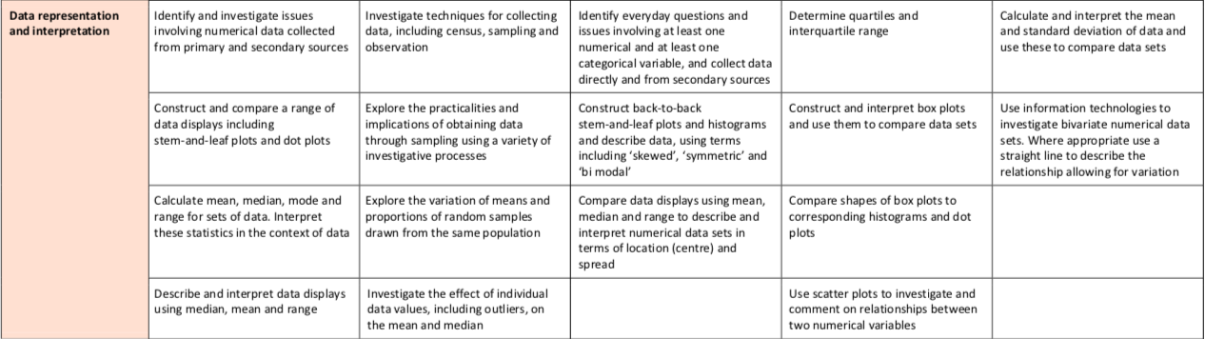
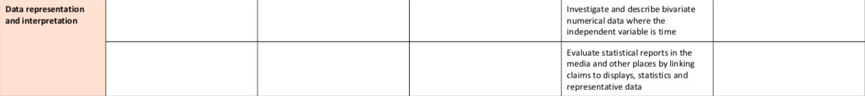
The Judging Standards for this unit (aka - How You will be Assessed!)

Slide 3
Starter Problem – To be done in pairs/groups of no more than 4
A class of 25 students was weighed, with their mean weight being 75.4kg. Kobi was asked to leave the room and the class was immediately weighed again, with their average weight now being 74.6kg. How much does Kobi weigh?

Slide 4
Standard Deviation EQ: What is standard deviation and what can it tell us about a data set?
Summary:

Slide 5
Standard Deviation EQ: What is standard deviation and what can it tell us about a data set?
McDonalds and KFC are arguing over who sold the most chicken nuggets in one week. Sales figures are below given to the nearest million, calculate the mean to help decide who sold the most.
 | Monday | Tuesday | Wednesday | Thursday | Friday | Saturday | Sunday
McDonalds | 1 | 1 | 1 | 4 | 8 | 8 | 5
KFC | 3 | 4 | 4 | 3 | 4 | 5 | 5
They both have the same mean!
4 million Chicken nuggets sold each day on average….
we need something else to determine whose sales are the best

Slide 6
Standard Deviation EQ: What is standard deviation and what can it tell us about a data set?
Up to this point, we have used the following measures of center and spread:
Measures of center: mean, median and mode
Measures of spread: range and interquartile range
Range and Interquartile range are limiting, as they only use a few data. The most commonly
used measure of spread is standard deviation.
Standard deviation is a measure of how each value in a data set varies or deviates from the mean

Slide 7

Standard Deviation EQ: What is standard deviation and what can it tell us about a data set?
sum of
each number
mean
how many numbers are in the set
Standard Deviation
$$σ=\sqrt{\frac{\sum{{\left(x_{i}−\overline{x}\right)}^{2}}}{n}}$$

Slide 8
Steps to Finding Standard Deviation
1. Find the mean of the set of data:
2. Find the difference between each value and the mean:
3. Square the difference:
4. Find the average (mean) of these squares:
5. Take the square root to find the standard deviation
That’s a lot of mathematical symbols, let’s see what this looks like with a set of data

Slide 9
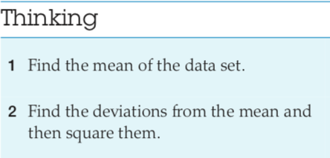
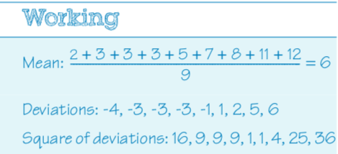
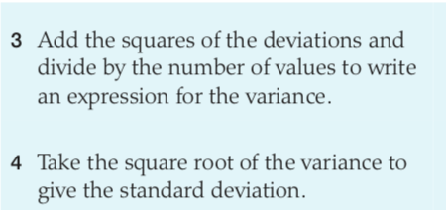
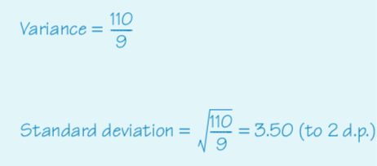
Guided Practice

Slide 10
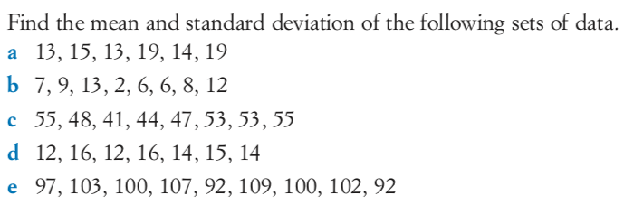
Independent Practice

Slide 11
Comparing data sets
Two math classes each took the same test, with 5 random students from each class getting the following scores :
Class A: 92,88,80,68 and 52 and Class B: 92,88,80,68 and 52
Find the standard deviation for each class and comment on what it says about the two classes.

Slide 12
Class A: 92,88,80,68 and 52.
Class B: 92,92,92,52 and 52.
1) Find the mean: (92+88+80+68+52)/5 = 76
1) Find the mean: (92+92+92+52+52)/5 = 76
2) Find the deviation from the mean:
92-76=16 88-76=12 80-76=4
68-76= -8 52-76= -24
2) Find the deviation from the mean:
92-76=16 92-76=16 92-76=16
52-76= -24 52-76= -24
3) Square the deviation from the mean:
3) Square the deviation from the mean:
4) Find the sum of the squares:
256+144+16+64+576= 1056
4) Find the sum of the squares:
256+256+256+576+576= 1920

Slide 13
Class A: 92,88,80,68 and 52.
Class B: 92,92,92,52 and 52.
5) Divide the sum of the squares by the number of items: 1056/5 = 211.2
5) Divide the sum of the squares by the number of items : 1920/5 = 384
Find the square root of the variance:
Find the square root of the variance:
Thus the standard deviation of the test scores is 14.53.
Thus the standard deviation of the second set of test scores is 19.6.

Slide 14
Analyzing the data:
Consider both sets of scores. Both classes have the same mean, 76. However, each class does not have the same scores. Thus we use the standard deviation to show the variation in the scores. With a standard variation of 14.53 for the first class and 19.6 for the second class, what does this tell us?
With a standard variation of 14.53 for the first class and 19.6 for the second class, the scores from the second class would be more spread out than the scores in the second class.
For two data sets that have the same mean, the smaller the standard deviation, the more closely packed is the data set (more consistently located with respect to the mean).

Slide 15
Back to our original problem...
McDonalds and KFC are arguing over who sold the most chicken nuggets in one week. Sales figures are below given to the nearest million, calculate the mean to help decide who sold the most.
 | Monday | Tuesday | Wednesday | Thursday | Friday | Saturday | Sunday
McDonalds | 1 | 1 | 1 | 4 | 8 | 8 | 5
KFC | 3 | 4 | 4 | 3 | 4 | 5 | 5
Find the standard deviation for both fast food franchises and comment on your findings. Answers on the next slide

Slide 16

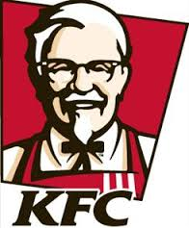
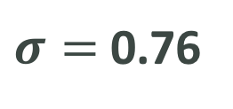

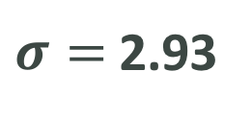

Standard Deviation EQ: What is standard deviation and what can it tell us about a data set?
$$\overline{x}=4$$
$σ=$ 2.93
How can we interpret this?
$$\overline{x}=4$$
$σ=$ 0.76
They both have the same mean but KFC’s sales are less spread about the mean.
You could say that KFC’s sales are more consistent. Which is ridiculous because everyone knows McD’s has the best nuggets

Slide 17
Standard Deviation EQ: What is standard deviation and what can it tell us about a data set?

Slide 18
Class/Homework
10ticks worksheet on Standard Deviation

Slide 19
Standard Deviation EQ: What is standard deviation and what can it tell us about a data set?
Complete your summary by answering the EQ
Summary:

